Slide 1
Analysing Algorithmic Patterns Based on Real Coding Interview Questions
By Ian Dempsey Supervisor: Dr.Hao Wu

Slide 2
Outline
Introduction.
Problem Formulation.
Software Framework.
Methodology.
Concrete Example.
Results.
Conclusions & Future Work.

Slide 3
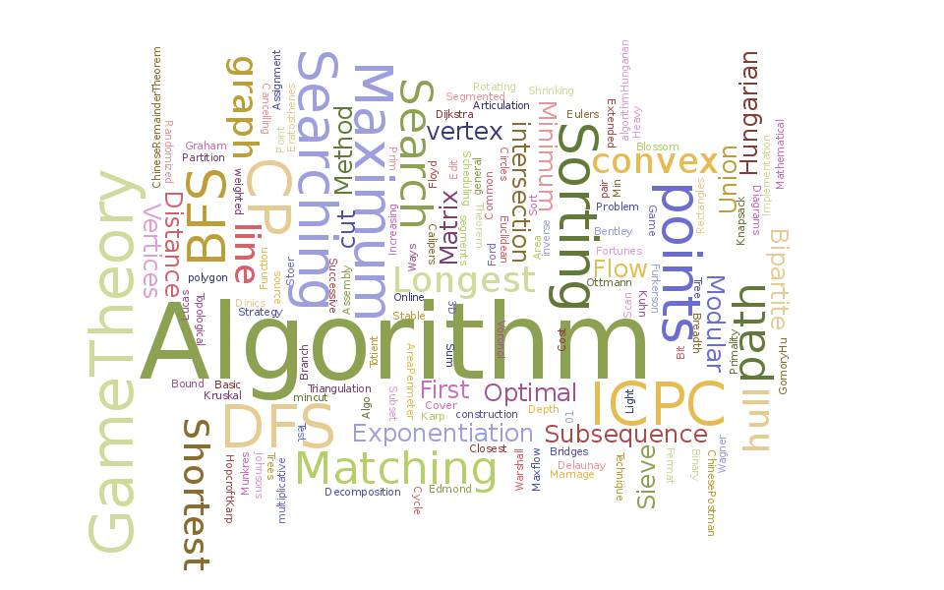
Introduction
Motivation
Interviews are becoming more technical.
Discover a relationship between algorithms and questions.
Contributions
Mastering the fundamental algorithms is important.
Identify the patterns of these algorithms.
Provide a guidance for programmers to better their abilities and prepare them for real world interview questions.

Slide 4

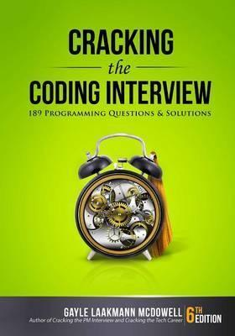
Problem Formulation
Related Works
Related works were good, but limiting.
5-10 questions per section.
Overlapping ideas.
Try to show the flexibility of algorithms.
Research Questions
What algorithms to choose.
How do the questions relate to these algorithms.
How easily can a person identify which algorithmic pattern to apply to a question.
Algorithms
Palindrome | Merge Sort
Binary Search | Tree Traversal
Breadth-First Search | Depth-First Search
Dynamic Programming

Slide 5

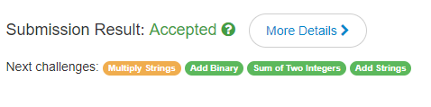
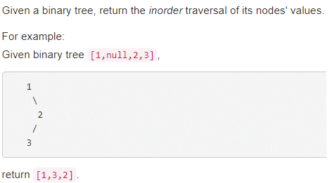
Software Framework
Online Repositories.
Active community.
Online judge system. Important.
Wide range of questions.
Java.

Slide 6

Methodology
1.Judge pattern
Take a moment to find which pattern suits the question.
2.Solve
Use the pattern to solve the question.
3.Compare
Compare Control Flow Graphs.
Edit Operations
Adding a node or edge.
Deleting a node or edge.

Slide 7
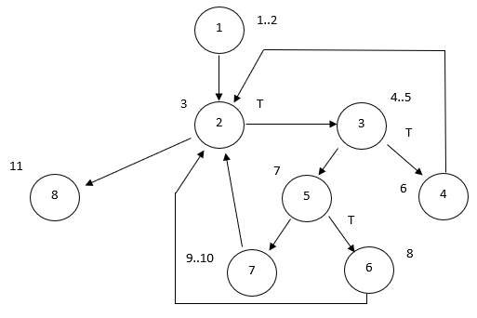
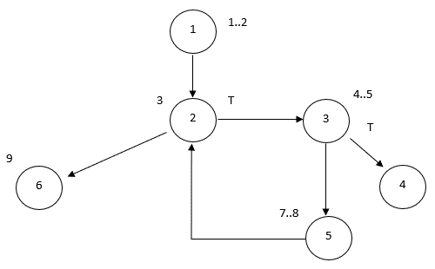
Concrete Example
CFG for Palindrome Algorithm
CFG for TwoSum question on LeetCode

Slide 8
Results

Slide 9
Conclusions & Future Work
Conclusion
Future Work
Readers learn that the patterns for standard algorithms are flexible.
Understanding the standard algorithms is useful for interviews.
The approach taken was manual, which was close to the interview experience.
Pilot study for future improvement.
Machine learning.
Develop an automatic validator of similarity.

Slide 10
Class | Group 1 | Group 2
Class 1 | 82 | 95
Class 2 | 76 | 88
Class 3 | 84 | 90

